Slide 1


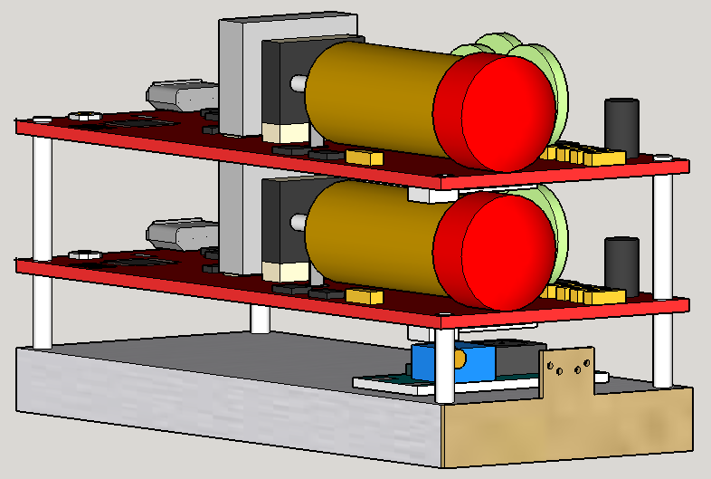


Investigating the Impact of a Solar Eclipse on Atmospheric Radiation
Josh Fender, John Ringler, and Justin Morse
DEPARTMENT OF PHYSICS AND ASTRONOMY, UNIVERSITY OF NORTHERN COLORADO, Greeley, CO 80639
FACULTY ADVISORS: C.GALOVICH, C. KUEHN, AND M.SEMAK
ABSTRACT
Identification of Muons
CONCEPT OF OPERATION
Muons are created when high energy cosmic particles like protons collide with atmospheric molecules, such as diatomic oxygen or nitrogen. These collisions create new molecules and decay products such as muons. It is known that there is a relationship between muon production and increasing altitude.
For this project, we have developed a method for the detection of cosmic ray muons as a function of altitude. The detector is part of a self-contained autonomous payload that is carried up to altitude aboard a weather balloon. The payload contains a plastic scintillator coupled with a silicon photomultiplier connected to a coincidence circuit with two Geiger counters which serve as the actual detection apparatus. The detector along with various other sensors including internal temperature sensors and an altimeter are controlled by an onboard microcontroller in the form of an Arduino Mega.
The payload will reach an altitude of between 15 and 20 miles and must be able to endure harsh conditions including:
Temperatures ranging from -80°C to 25°C
Accelerations up to 8 G’s
The current experiment is built upon previous attempts to measure muon flux as it varies with altitude using Geiger–Müller tube. A major downfall of the use of single Geiger–Müller tubes is that any charged particle will trigger a “count” on the device. To help identify just the muons that passed through the payload, three tubes were wired to a coincidence circuit. Only when at least two of the tubes were triggered simultaneously would the muon count be increased. Stacking the Geiger–Müller tubes vertically allowed us to distinguish the direction from which particles were detected. Only particles that came from a small arc directly above the tubes would be detected. To increase the detection angle, three Geiger–Müller tubes were used (Fig. 2).
This experiment will see the replacement of the third Geiger–Müller tube with a silicon photomultiplier (SiPM) coupled to a Cesium iodide (CsI) scintillation crystal (Fig. 2, Object C and Fig 3). When incident particles enter the CsI crystal, they excite the atoms in the structure and cause them to eject photons. The energy released due to these photons is directly proportional to the energy of the incident particle as well as the amount of material the particle has penetrated. This means that every particle detected has a characteristic intensity. This unique design, utilizing both Geiger–Müller tubes and a scintillation detector should provide greater certainty in the identification of muons from other forms of ionizing radiation.
3. At apogee, the balloon will burst and begin to undergo rapid acceleration towards the ground and free fall.
2. The balloon carrying the payload will be released, accelerating the payload upwards.
A
1. Approximately 20 minutes prior to flight the flight computer and various subsystems will be powered on. The flight computer will give an indication via LEDs that the payload is functioning correctly. The payload will begin to send initial data back to a laptop via an xBee radio.
4. As the payload passes into ticker atmosphere, a parachute will deploy, slowing the payloads decent.
B
5. The flight team will arrive at the landing site to retrieve the payload.
Figure 4. Overview of the expected flight plan
C
TESTING
In order to ensure our payload’s readiness, we rigorously tested the electronic and structural components.
Electronics Tests
All sensors and the program code were run for a duration of 4 hours (approximately the length of the launch)
All data collected during this period were compared with known values to ensure each sensor’s accuracy
Physical Tests
Dropped the payload from a height of approximately 40 feet to test payload survivability during a hard landing
Whip tested to determine payload survivability during large accelerations
Cold tested to simulate payload functionality in a low-temperature environment, such as found in the upper atmosphere
EXPECTED DATA
Figure 2. The orientation of detectors, A, B, and C. The lines indicate the detection window. Only when a particle passes through at least two of the detectors does it trigger a muon count.
The payload will experience a change in radiation flux as it ascends. We expect the muon count to increase with altitude until between 60,000 and 70,000 feet. At altitudes above this, we expect the count to decrease with altitude (Fig. 1). This curve in the muon count was first discovered by Erich Regener and Georg Pfotzer in the 1930’s is known as the Pfotzer Curve. The dip in the muon count at higher altitude is caused by less atmosphere being present, and thus fewer radiation scattering events taking place.
Michael Palmer, emeritus professor from West Virginia University, developed a mathematical model to predict the amount of muon flux as a function of altitude. We have adapted his model to fit our collected data (Fig. 1).
A portion of the cosmic rays that generate the showers of muons originate from our Sun. During the eclipse we expect to observe a lower overall count rate during the actual eclipse caused by the rays from the Sun being blocked by the moon.
In addition to the replacement of the third Geiger–Müller tube, thin sheets of lead will be added above each of the tubes. The sheets of lead will act as filtering agents by attenuating the radiation caused by particles other than muons. The muon has much higher energy than other particles and not as easily deflected by lead. In this configuration, a coincidence count will consist of a positive detection signal from at least one of the Geiger–Müller tubes as well as from the scintillation detector.
A
Post Flight
After recovery of the payload, we will inspect it for damage and retrieve the stored data. We will analyze the data by comparing the new data to the results of past experiments, as well as the Palmer model calculated for the flight. We will then use this information to improve on our construction techniques and data collection procedures for future flights.
Our intention is to use the results from this flight, as well as the results from the Fall 2016 flight as baseline data for the upcoming flight during the 2017 solar eclipse. By showing that the Palmer model can accurately predict the shape of the counter rate vs altitude curve, we will be able to use it as a tool to analyze any anomalies detected during the eclipse.
B
C
D
Geiger–Müller tube A
Geiger–Müller tube B
Scintillation crystal wrapped in Mylar to provide a light barrier
Silicon photomultiplier (SiPM)
Figure 3. 3D rendering of the Geiger–Müller tubes and SiPM.
Acknowledgments
Figure 1. Muon count versus altitude. The blue data points were collected during a balloon flight in the fall of 2016. The green line is a mathematical model developed by Michael Palmer.
Many thanks to: Chris Koehler, Bernadette Garcia, the Colorado Space Grant Consortium, and NASA for their support with this project.

